Slide 1

IT496: Introduction to Data Mining
Lab - 02
Data Preprocessing
Arpit Rana
11th Aug 2023

Slide 2
Data Quality
Data has quality if it satisfies the requirements of the intended use.
Example
In a customer database, some of the customer addresses are outdated or incorrect, yet overall, 80% of the addresses are accurate.
For a marketing analyst, this data is large and accurate; but, not for the sales manager.

Slide 3
Data Quality
The real-world databases and data warehouses have the following characteristics:
Incomplete (lacking attribute values or certain attributes of interest, or containing only aggregate data);
Inaccurate or noisy (containing errors, or values that deviate from the expected); and
Inconsistent (e.g., containing discrepancies in the department codes used to categorize items).
To make the data usable, it needs to be preprocessed.

Slide 4
Data Quality
The four major techniques of data preprocessing
Data Cleaning,
Data Integration,
Data Reduction, and
Data Transformation

Slide 5
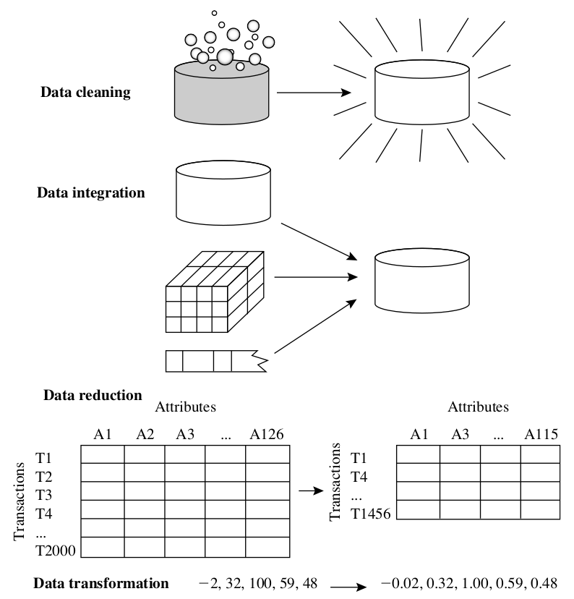
Forms of Data Preprocessing
These techniques are not mutually exclusive, they may work together.
E.g., data cleaning may involve transformation to correct wrong data

Slide 6
Data Cleaning
It involves to “clean” the data by
Filling in missing values,
Smoothing noisy data,
Identifying or removing outliers, and
Resolving inconsistencies.

Slide 7
Data Cleaning
Missing Values
Ignore the tuple
This is usually done when the class label is missing (and the task is classification).
Fill in the missing value manually
Time consuming and may not be feasible
Use a global constant to fill in the missing value
It is simple, but not foolproof.
Use a measure of central tendency for the attribute (e.g., the mean or median)
For symmetric data, use mean; for skewed, use median.
Use the attribute mean or median for all samples belonging to the same class as the given tuple
Use the most probable value to fill in the missing value
This can be determined with regression or inference-based tools.

Slide 8
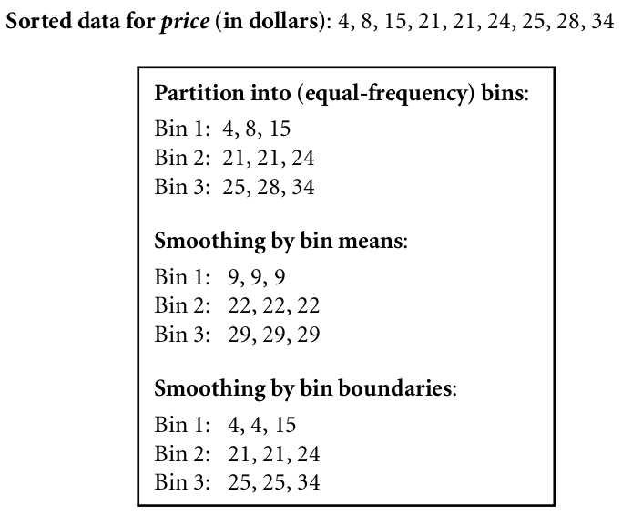
Data Cleaning
Noise
Noise is a random error or variance in a measured variable.
Smoothing Noisy Data
Binning
These methods smooth a sorted data by consulting its neighborhood.
The sorted values are distributed into a number of buckets or bins.
Regression
Outlier Analysis

Slide 9
Data Integration
Merging data from multiple databases or files may cause inconsistencies and redundancies.
Example
Some attributes representing a given concept may have different names in different databases,
e.g., customer_id or cust_id
Duplicate records

Slide 10
Data Integration
Entity Identification Problem
Some attributes representing a given concept may have different names in different databases,
e.g., customer_id or cust_number
Using metadata: name, meaning, data type, permitted value range, and null rules; entities can be identified.
Redundancy
An attribute can be redundant if it can be derived from another attribute or set of attributes.
Using correlation analysis, redundancies at the attribute level can be detected.
Tuple Duplication
Duplicate tuples (records) need to be identified and removed.
Data Value Conflict Detection and Resolution
Unit of values need to be same

Slide 11
Data Reduction
It obtains a reduced representation of the dataset that is much smaller in volume, yet produces the same (or almost the same) analytical results.
It includes the following strategies.
Dimensionality Reduction, reducing the number of (non-essential) attributes (e.g., PCA, SVD)
Numerosity Reduction, reduces the number of instances in the dataset (e.g., sampling, clustering)

Slide 12
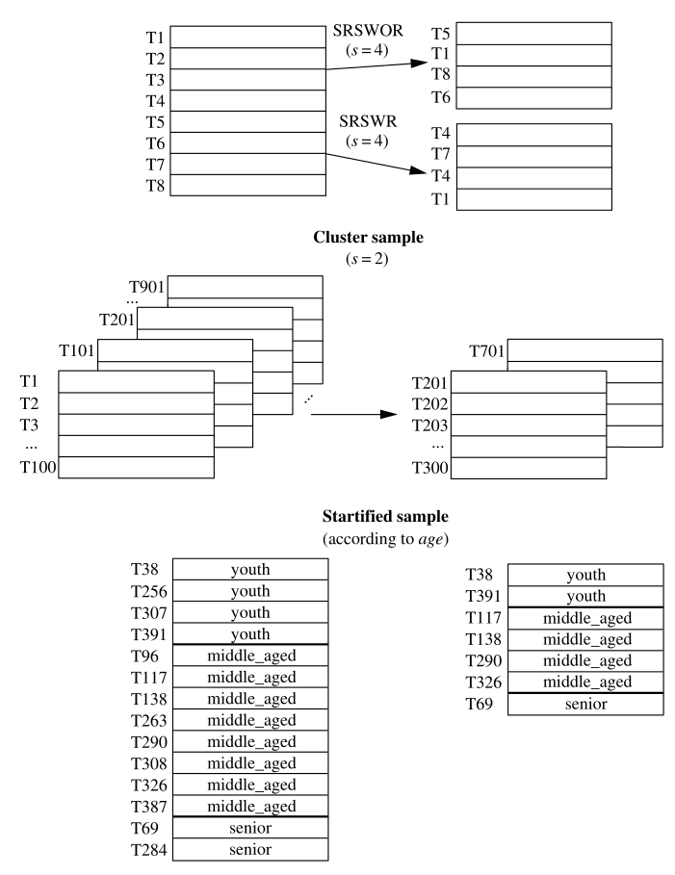
Data Reduction
Sampling
Let dataset D contains N tuples. The most common ways to sample D for data reduction are -
Simple random sample without replacement (SRSWOR) of size s (s < N)
Simple random sample with replacement (SRSWR) of size s (s < N)
Cluster sample: If the tuples in D are grouped into M mutually disjoint “clusters,” then an SRS of s clusters can be obtained, where s < M.
Stratified sample: If D is divided into mutually disjoint parts called strata, a stratified sample of D is generated by obtaining an SRS at each stratum.

Slide 13
Data Transformation
The forms of Data Transformation are -
Normalization
where the attribute data are scaled so as to fall within a smaller range, such as −1.0 to 1.0, or 0.0 to 1.0.
Discretization
where the raw values of a numeric attribute (e.g., age) are replaced by interval labels (e.g., 0–10, 11–20, etc.) or conceptual labels (e.g., youth, adult, senior).
Concept Hierarchy Generation
where attributes such as street can be generalized to higher-level concepts, like city or country.

Slide 14
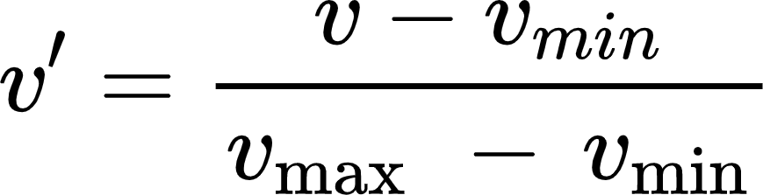
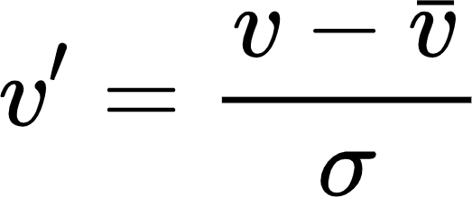
Data Transformation
The forms of Data Transformation are -
Normalization
where the attribute data are scaled so as to fall within a smaller range, such as −1.0 to 1.0, or 0.0 to 1.0.
Min-Max Normalization
Z-score Normalization
This method is useful when the actual minimum and maximum of an attribute are unknown,
or
when there are outliers that dominate the min-max normalization.

Slide 15
Data Transformation
Concept Hierarchy Generation
There are two important methods of concept hierarchy generation -
Specification of a partial ordering of attributes explicitly at the schema level by users or experts
E.g., street < city < province or state < country.
Specification of a set of attributes, but not of their partial ordering
Using a heuristic that high-level concepts have lesser number of distinct values than the ones with low-level concepts.

Slide 16
IT496: Introduction to Data Mining
End-to-End ML Project
in Python
17th August 2023
Next Lab

